Slide 1
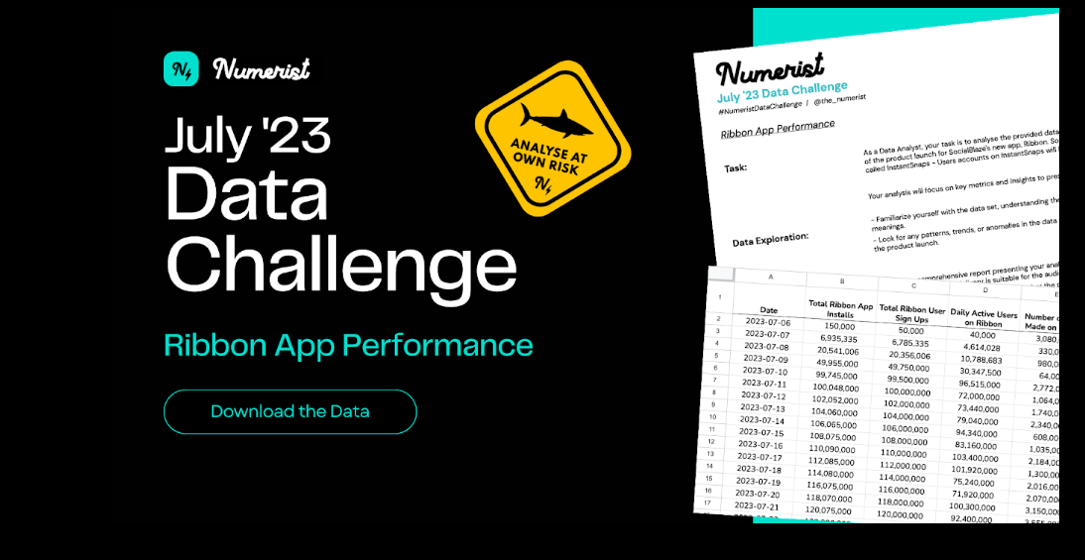
Analysis Report
By Femi Tunde-Adedipe and Ilias Shittu-Gbeko

Slide 2

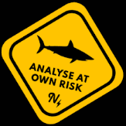
Ribbon
Table of Contents
Executive Summary
Key Metrics and Findings
Success of the App Launch
Opportunities for Enhancement
User Acquisition and Engagement
Actionable Recommendations

Slide 3

Ribbon
Executive Summary
July 6th, 2023, SocialBlaze launched its latest social media app called Ribbon to the public and it has been 31 days since the launch of the new app. SocialBlaze has another social media app called Instantsnaps which has its data linked to the new Ribbon app
Since the launch of the new app, there have been over 3 billion installations and sign ups, with its daily active users for the month of July-August exceeding 2.5 billion.
Despite these staggering metrics, the app also comes with its own shortcomings which will be further discussed in this presentation.
This presentation walks the audience through the analysis carried out on the dataset and answers questions such as
Can the launch of the app be considered a success?
(If the app is a success) How can the success of the app launch be used to further enhance SocialBlaze’s products and services?
Are there any opportunities for expansion or improvements in user acquisition and engagement?

Slide 4
Ribbon
Key Metrics and Findings
Avg Daily Active Users
Days Since Launch
85.07M
31
Total App Installs
Total App Signups
Total Active Users
Avg Time Spent
Total App Crashes
3.43B
3.426B
2.637B
76.97%
318.2
1.52M
100%
99.90%
76.97%
Total Engagement
Total Uninstalls
2.36B
872.3k
Between July 6 and August 5, there was a total of 3.43 billion installs and of this, 3.426 billion people signed up to use the app. Of the 3.426B people who signed up, 2.637 billion people were active on the app within this period, which translates to 76.97% conversion rate. Although these numbers are quite impressive, the app has crashed over 1.5 million times and there has been over 870 thousand uninstallations.
On the average, there have been 85.07 million daily active users with their engagement totaling 2.36 billion. Within the first month, the users have spent an average of 318.2 minutes on the app.

Slide 5

Ribbon
Success of the App Launch
To determine the success of the app launch, the metrics from the Ribbon app would be compared against industry standard metrics and/or leading social media platforms.
The metrics which we would use would be
Retention Rate
Time Spent on the app
Visibility Rate

Slide 6
Ribbon
Success of The App (Retention Rate)
The Ribbon app has a 76.9% conversion rate i.e., from installation to being a daily active user, but retention rates across the social media app category are fairly close to the global average. They start at 26.3% for day one, dropping to 9.3% by day seven. Statista puts the day 30 average at 3.9%, while AppsFlyer quotes 3.11%.
Comparing the 30-day retention rate average to quotes by Statista and AppsFlyer, Ribbon app’s retention rate is over 21 times the global average.
Total App Installs
Total App Signups
Total Active Users
3.43B
3.426B
2.637B
76.97%
100%
99.90%
76.97%

Slide 7
Ribbon
Success of The App (Time Spent)
Despite the fluctuating time spent on the app every day, the average time spent on the Ribbon app is 318.2 minutes.
According to Sprout social, The amount of time internet users spend on social media is now higher than ever — 151 minutes per day. Going by this general metric, it is safe to say that the content on Ribbon app is captivating enough to keep its users engaged for at least twice the amount of time internet users spend on social media.

Slide 8
Ribbon
Success of The App (Visibility Rate)
In the first month of launch, a staggering 65.28 million posts were made but only 25.38 million posts were seen by the users. This means only 38.9% of all posts were visible to the users.
According to Hootsuite,
Facebook: 5-10% of your followers will see your posts in their News Feed.
Instagram: 5-15% of your followers will see your posts in their Feed.
Twitter: 20-30% of your followers will see your tweets in their timeline.
LinkedIn: 10-20% of your connections will see your posts in their Home feed
Going by this metric, the visibility rate of the Ribbon app surpasses that of other leading social media apps.
Percentage of unseen posts
Percentage of posts seen
38.9%

Slide 9

Ribbon
Opportunities for Enhancement
Has the app been a success so far? Without doubt, We can say the app has been a success.
To leverage the success of the app launch to further enhance the company’s products and services, the app must be used to promote the company’s other products.
Social media marketing is the way to go for promoting the organization’s products. According to Sprout Social, social media recently overtook paid search as an advertising channel, growing 25% YoY and exceeding $137 billion (just edging out search’s $135 billion). This statistic is a testament to how much impact social media has when it comes to advertising.

Slide 10

Ribbon
Opportunities for Enhancement
Marketing on the Ribbon app is the way to go but how can this be achieved?
Creating video contents about our services is the best way to enhance our services. This is because,
87% of marketers say video marketing has helped them drive more sales.
51% of people are more likely to share videos with friends and family over any other content type.
More than 54% of marketers say that video is the most valuable content type for achieving social media marketing goals. Yet, video is also the most underutilized format across Facebook, Instagram and Twitter, comprising 14%*, 11% and 5% of each network’s content respectively.
93% of companies have acquired new customer(s) via social media video.
In addition to video contents; 26% of people say they are more likely to share social media posts with family and friends. This can also be exploited alongside video form content.

Slide 11

Ribbon
Opportunities for Enhancement
Despite using video form content, we also have to be careful not to go overboard and stick to short-form video contents for marketing our products.
The use of short form video as a marketing tool is essential because:
Short-form video offers marketers the highest ROI of any social media marketing strategy.
93% of social media marketers who use video say it’s a vital component of their social media video strategy. Even more so if the video is short-form, which consumers find 2.5 times more engaging than long-form video. However, despite being a vital component, video is still widely underutilized across major social media networks.

Slide 12

Ribbon
Opportunities for Enhancement
Another method to use the Ribbon app for enhancing services is Influencer Marketing.
Influencer marketing is a sort of social media marketing that combines endorsements and product placements from individuals. On social media, influencers have amassed a sizable and active following, and their followers trust the advice they give. Because of this, brands looking to target a certain market and create discussion about their goods or services can benefit from partnering with them.
Why Influencer Marketing?
Considering 56% of young Americans have purchased a product after seeing a post from someone they follow; influencer marketing can be an incredibly powerful marketing tool for your brand.
83% of marketers said influencer marketing was an effective form of marketing. The report also noted that 67% of marketers plan on increasing their budgets for 2023.

Slide 13
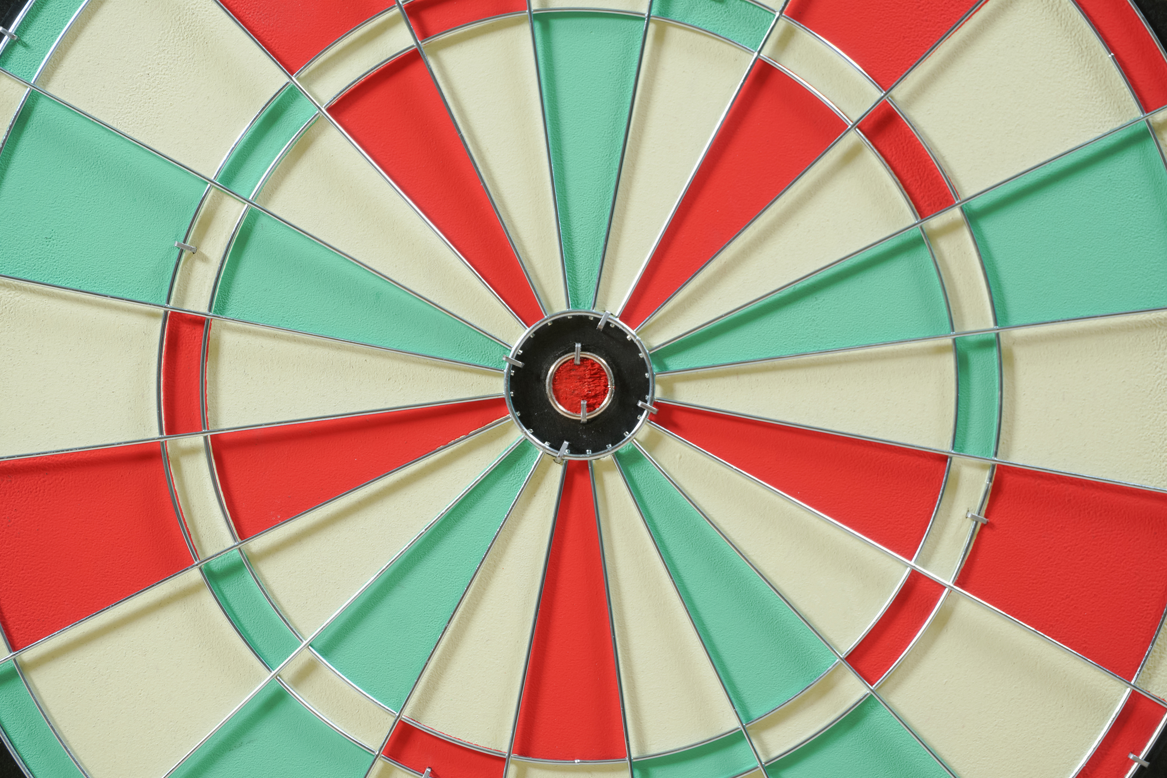
Ribbon
Opportunities for Enhancement
After all other forms of marketing have been carried out, retargeted ads is a MUST.
Online advertisements that target users who have already visited your website or app are referred to as retargeted ads or remarketing ads. This can help us attract clients more effectively by connecting with those who are already interested in our goods or services.
Why retargeted ads?
Retargeting ads are the most-used among marketers, with 77% of B2B and B2C marketers alike saying they use retargeting as part of their Facebook and Instagram advertising strategies.

Slide 14
Ribbon
User Acquisition and Engagement
Despite the staggering figures for Ribbon’s Daily Active Users, its high level of engagement on posts seen, the app has a long way to go when it comes to user acquisition and engagement when compared to Instantsnaps. Although, Instantsnaps has exsited for quite a while before Ribbon, the success of Instantsnaps can be leveraged upon to increase Ribbon’s user acquisition and engagement.
The daily active users on Instantsnaps has been in an uptrend since 11 July 2023 while Ribbon app has a fluctuating daily active user. On the Ribbon app, the DAU fell by 42% between July 31st and August 5th. Despite users' accounts being linked between the two apps, only 0.087% of Instantsnaps users are on Ribbon.

Slide 15

Ribbon
User Acquisition and Engagement
Leveraging on Instantsnaps, aggressive marketing for Ribbon needs to be carried out on Instantsnaps, the option to post simultaneously on both apps without the need to open and post separately on both apps needs to be provided.
Other methods which could be explored to improve user acquisition and engagement include
App store optimization (organic acquisition)
Invest in a retargeting campaign
Finally, there is a need to increase posts visibility. Clearly, when a post is seen, there is high level of engagements. To do this, rather than limiting posts to users followers, it could be better to allow users select a range of topics they are interested in, create an algorithm to group posts under different topics and push these posts to users’ timeline.

Slide 16
Ribbon
Actionable Recommendations
The success of Instantapps needs to be leveraged to increase user acquisition and engagement for Ribbon app. Especially using Instantapps to market ribbon app
Find Instantsnaps features that can be incorporated into ribbon to boost user activity and promote use of both apps.
Push posts which interests each user to their timeline. For example, since the data on Instantsnaps and ribbon is linked, user interests from Instantsnaps can be pushed to a users’ timeline. Cookies can also be used to track browsing activity, so this can be used to track users interests.
Create incentives for users with high engagements on the app.
Make the ribbon app a market hub. Create an avenue for entrepreneurs to market their products on the app. Asides from increasing the apps’ revenue, this also increases user acquisition and engagement.

